Slide 1
Green Technology Training Modules in Education
Discover the importance of incorporating green technology training modules in education and the many advantages they bring, from environmental benefits to cost savings and career opportunities.

Slide 2
Advantages of Green Technology Training Modules
Environmental Benefits
Cost Savings
Career Opportunities
Learn how incorporating green technology in education contributes to a sustainable future, reduces carbon footprint, and promotes eco-consciousness.
Explore how green technology training modules can help educational institutions save on energy costs through efficient systems and sustainable practices.
Discover the increasing demand for professionals skilled in green technology and the vast array of career paths in sustainability and renewable energy.

Slide 3
Challenges in Implementing Green Technology Training Modules
1
Lack of Awareness
2
Resistance to Change
3
Infrastructure Limitations
Address the lack of understanding and awareness among educators and students about the importance and benefits of green technology in education.
Recognize the resistance faced when implementing new strategies and technologies and discuss effective ways to overcome resistance and foster acceptance.
Explore the challenges posed by existing infrastructure and discuss strategies to overcome limitations in implementing green technology training modules.

Slide 4
Strategies for Successful Implementation
1
Collaboration with Industry Partners
Highlight the significance of partnerships with industry experts and organizations to provide real-world expertise and support in implementing green technology training modules.
2
Teacher Training and Professional Development
Emphasize the importance of equipping teachers with the knowledge and skills necessary to effectively incorporate green technology modules into their curriculum.
3
Integration into Curriculum
Outline practical ways to seamlessly integrate green technology training modules into existing curriculum, fostering multidisciplinary learning experiences.

Slide 5
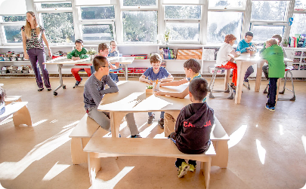
Case Studies of Successful Green Technology Training Programs
Forest Hill Elementary
University of Sustainability Studies
WindTech High School
Discover how Forest Hill Elementary successfully integrated green technology training modules into their curriculum, inspiring students to become eco-conscious leaders.
Learn how WindTech High School incorporated hands-on experiences with wind turbines to provide students with practical skills in renewable energy technologies.
Explore the University of Sustainability Studies' innovative green technology training program, equipping students with the knowledge and skills to drive change.

Slide 6
Conclusion: The Future of Green Technology in Education
Look ahead to a future where green technology is fully integrated into education, empowering a new generation of environmentally conscious innovators and leaders.

